Slide 1
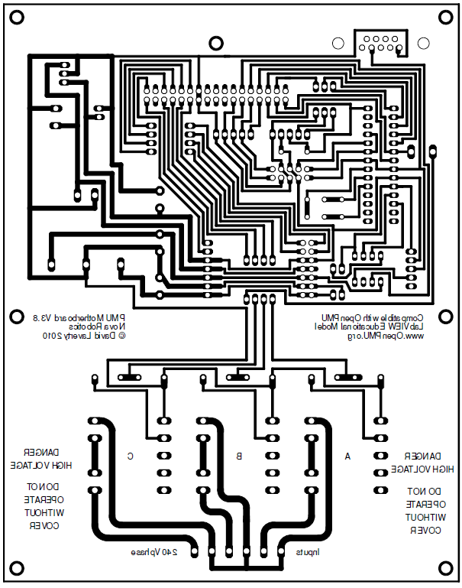
COM PORT
7805
D1 5V RED LED C1 100 μF / 50 V
C2 100 μF / 50 V C3 100 μF / 50 V C4 100 pF C5 100 pF R1 100 kΩ R2,4,6 430 Ω R3,5,7 240 Ω XTAL 4 MHz
Wire Link
D1
34-way header
+
1
Screw Terminal
PIN Header
18F252
1
Traco Power Unit
Screw Terminal
R1
10-way
C1
C4
+
C5
XTAL
+
C2
+
Screw Terminal
14-way
Screw Terminal
C3
1
SN75155P
R2
R3
R4
R5
R6
R7
Transformer C
Transformer B
Transformer A
Screw Terminals

Slide 2
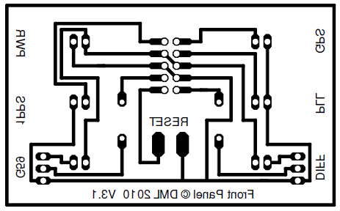
D1-D4 5V GREEN LED D5 5V AMBER LED
D6 5V RED LED
R1,R2 240 Ω T1,T2 NPN Transistor (General Purpose)
+
D1
+
D2
10-way header
D3
+
+
D4
R1
R2
T1
D5
+
+
D6
T2

Slide 3
18F252

Slide 4
POWER
VT
DAQ
VT
TIMING
VT
RS232

